Slide 1


School Information Report
St Peter’s Church of England Primary Academy

Slide 2

The Special Educational Needs Information Report (SIR) for St Peter’s Church of England School SEN Information Report 2025-2026
URN | 8123059 | Head Teacher | Miss Ann-Marie Wilson
Local Authority | North East Lincolnshire | Assistant Headteacher | Mr Jason Foxon
Type of School | Primary | SENDCO | Mrs L Hodge
School Category | Academy | Pastoral Officer | Mrs J Barrass
Age Range | 4 - 11 | Chair of Governors | Mrs K Esmond
Number On Roll | 179
Glossary of terms
ASD | Autistic Spectrum Disorder
CAF | Common Assessment Framework
CAMHS | Child and Adolescent Mental Health Service
CIN | Child in Need
Code of Practice | This is the code in which all teachers work within with children with Special Educational Needs.
CP | Child Protection
EYFS | Early Years & Foundation Stage
HLTA | Higher Level Teaching Assistant
IEP | Individualised Education Plan
MAP | Multi-Agency Pathway
PO | Pastoral Officer
SENDCO | Special Educational Needs & Disability Coordinator
Single Assessment | Single Assessment Process identifies additional needs of a child that one service cannot address alone.
SLT | Senior Leadership Team
TA | Teaching Assistant
YMM | Young Minds Matter

Slide 3
St Peter’s C of E Primary Academy (SPA) seeks to provide a high-quality academic education for all pupils according to their individual needs, and to develop attitudes of mutual respect and responsibility. It aims to give high priority to the spiritual development of the whole school community in a Christian environment. We are committed to offering an inclusive curriculum to ensure the best possible progress for all of our pupils whatever their needs or abilities, ensuring they feel valued, valuable and empowered to be the best they can be, living ‘life in all it’s fullness’ (John 10:10)

Slide 4
How the school identifies pupils with Special Educational Needs: At St. Peter’s Primary School children are identified as having Special Educational Needs through a variety of ways including the following: Early years baseline assessments and progress tracking to ensure early identification, which is always prioritized Liaison with previous school/setting Conversations with parent following concerns – via our open-door policy. Conversations with staff following concerns raised regarding academic progress and/or other progress. Insight tracking, ‘IEP’ Meetings, pupil progress/SEN meetings and Small Steps Documents. Pupil progress is measured and tracked for each child on a termly basis by the Headteacher. Children with special educational needs are also monitored by the Special Educational Needs and/or Disability Coordinator (SENDCO) on a termly basis. The SENCO meets termly with the class teachers to monitor progress. Liaison with external agencies and other professionals Identification through involvement with SALT/YMM/TAF/Neurodevelopmental services meetings and other external services including healthcare professionals. Identification by our Speech and Language Therapist who visits the school termly to assess children presenting with speech, language and communication needs. Children will have been regularly monitored, progress tracked and the appropriate referrals carried out to ensure the children’s needs have been identified and actioned as early as possible in their primary career.

Slide 5
How parents can raise any concerns they may have: First point of contact would be the class teacher who would in turn signpost as necessary to an appropriate member of staff Discussion with the SENDCO. SEND Governor is available to discuss any concerns you wish to raise Headteacher if concerns need to be taken further The decision-making process: The decision regarding in-class support is usually made with the Class Teacher and Teaching Assistant; decisions regarding additional support are usually made in collaboration with the SENDCO, Class Teacher, Higher Level Teaching Assistant and Teaching Assistant. Throughout the year, there are pupil progress meeting which involves the Class Teacher, Class TA, Headteacher and SENDCO. The aim of this meeting is to obtain a comprehensive view of all children, their individualised and holistic needs and to ensure they are making good academic progress. Results of this review inform planned intervention. The advice, support and recommendations of any other professionals involved with the child are included and addressed within additional support or intervention the child is receiving.

Slide 6
What is the school's approach to SEND Support? At St Peter’s, we use the Graduated Approach to support children with SEND. This is a systematic method support children using a four-step cycle: Assess, Plan, Do Review.

Slide 7
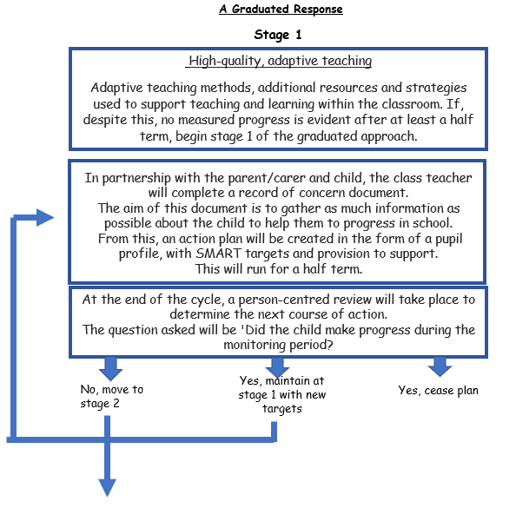

Slide 8
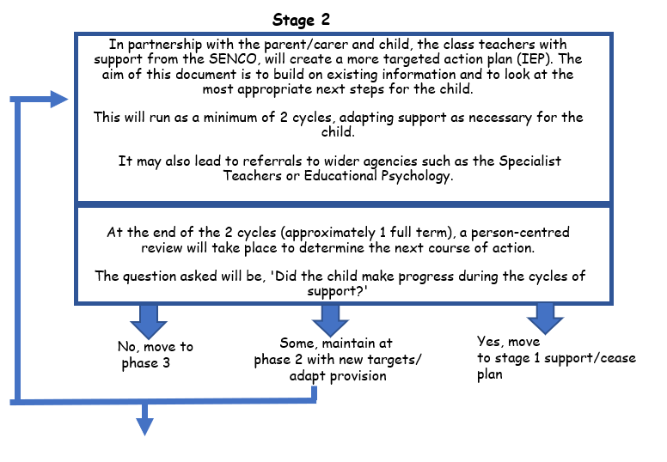

Slide 9
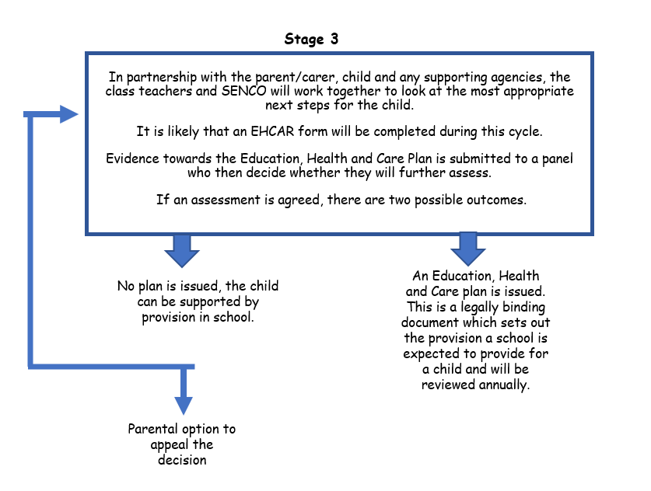

Slide 10
Parental involvement: Parents are invited into school for a minimum of three meetings to discuss the needs of their child. Time is also allocated during Parent’s Evening and when end of the year reports have been handed out to discuss any information for their child. Advice is given to parents as to how best they can support their child at home via discussions with parents and specific workshops aimed at helping parents to support their child’s learning with the involvement of the pastoral team (where necessary).

Slide 11
How the school oversees and plans education programmes for pupils with SEN Initially the school will map out the individual child’s needs and then identify appropriate support and/or intervention. This is monitored and evaluated through target setting in IEP’s, entry and exit point assessments, observations and discussions with adults working with the child. Some examples of equipment/resources available to pupils In school include: disabled toilet, shower facilities, specialist seating - seating cushions and therapy bands, writing slopes, coloured overlays, pencil grips and adapted writing pens, calmers (squeezy/stress balls etc), sand timers, Communicate in Print - a visual/picture resource to support language, physiotherapy equipment, e.g. gym mats and gym balls. Next, are some examples of what our school can provide for the four broad areas of SEND…

Slide 12
Cognition and Learning (Learning Need) Adapted approaches to learning, e.g. visual, hands-on Adapted work expectations, matched to the child's ability Different/extra resources, e.g. word cards, number squares Special Literacy or Numeracy programmes, e.g. IDL Literacy, IDL Numeracy and Precision Teaching, Extra adult support, group work, individual support Communication and Interaction (Speech and Language) Communication and language games Social skills games. Social skills programmes of intervention (Talkabout). Specific Speech and Language programmes provided by the Speech and Language Therapy Service Communication in Print - a visual/picture resource to support language and communication Colourful semantics. Social, Emotional and Mental Health De-escalation plans which outline a pupil's difficulties and the best strategies to use to help them Social skills games (Talkabout, Lego Therapy). Reward strategies Access to a trained Social, Emotional, Mental Health Lead/Pastroal assistant to deliver group or individual interventions. THRIVE approach. Behavioural support plans (where appropriate). Medical, Physical and Sensory Needs Specialist equipment such as seating, writing slopes, pencil grips and calmers Sensory circuits Specialist training from outside agencies, such as specialist nurse for pupils with disabilities and teachers of the hearing and/or visually impaired

Slide 13
Who supports pupils with SEN – what are their roles? Any of the Teaching Team can work with individual children and/or small groups and can support the pupils and/or Class Teacher within the classroom setting and within the wider community. The interventions that focus on learning are overseen by the SENDCO (Mrs Hodge). Mrs Barrass leads the Pastoral Team and ensures the needs of the holistic child are addressed. How is information communicated to parents? All letters and communications, including from any outside agency (Specialist Teaching Service, Young Minds Matter, Speech and Language, Educational Psychology etc.) are relayed back to parents with support and advice offered. IEP, support and advice meetings are conducted with parents to ensure up to date and relevant targets are in place. If parents are concerned about learning or any aspect of Special Educational Needs, then parents can email or telephone the school to speak to someone or make an appointment to come into school to share their concerns. How are governors/trustees, management committees involved and what are their responsibilities? Governors are involved on a termly basis when they consider reports on SEND, also through the consideration of personnel, finance and standards reports. Our SEND Governor, meets with the SENDCO on a regular basis to address anything and everything related to SEND.

Slide 14
What are the pastoral and social support systems available for pupils? Our Pastoral Team work with children on an individual and group basis. All children are considered in terms of their individual needs. In this way, children are provided either with specific support or within small group support. School staff also maintain pastoral records via CPOMS, the market leading safeguarding and well-being solution where teachers, teaching assistants and lunchtime supervisors can comment. These records are read and responded to daily and can identify any children who may require additional pastoral support or just someone to talk issues over with. Where further guidance and support is needed, concerns are discussed with the Headteacher/SLT through weekly safeguarding meetings. How does the school manage the administration of medicines? School manages the administration of medicines by means of a specifically locked resource. School will only administer prescribed medication and parents are requested to complete a consent form. Most of our teaching assistants and lunchtime supervisors are qualified first aiders. First Aiders are trained in administering medicines. Training is provided and continually updated. For more details, please refer to our Supporting Pupils with Medical Conditions Policy.

Slide 15
What support systems are in place for addressing behaviour, avoiding exclusions and increasing attendance? We have a positive approach towards behaviour in our school, and this is used with Reception Class through to Year 6. This system is used by all stakeholders within the school ensuring a consistent approach across the school. St Peter’s C of E Academy will be launching ‘Thrive’ in September 2025, a trauma-informed approach to improving the mental health and wellbeing of children and young people. Where appropriate, children may be highlighted for individual behaviour plans, individual behaviour reward charts, and individual home school books. This is via direct communications with Teachers and SLT to create a bespoke package more fitting to their needs. First day contact is in place for pupils who are absent from school. Daily register trawls are conducted; home visits and invitations to attend face-to-face meetings with the Pastoral Officer are in place. Where necessary further support is sought from the Education Welfare Service (EWS) and School Attendance Targets are set for pupils and parents where attendance is an ongoing issue. Daily Persistent Absence monitoring helps to highlight pupils of concern and results in intervention and support from the Pastoral Officer and where necessary other agencies, e.g. EWS. Weekly ‘Celebration Worships’ incorporates celebrating the children’s efforts every Friday morning. Parents and family members of the selected children are all invited to take part and share their child’s excellence each week with the children in the Celebration Worship.

Slide 16
How are the views of pupils taken into account? The views of the pupils are obtained by the school council, which has two representatives from each class; the school council meets regularly with the SENDCO to discuss ongoing issues. The Pastoral Team completes pupil questionnaires with every child in school to gain their feelings and views about school life, routines and their own well-being. The outcomes of pupil surveys are shared with class teachers and SLT to ensure that any issues arising can be addressed promptly.

Slide 17
In addition to normal reporting arrangements, what opportunities are there for parents to discuss their child’s progress with staff? We have an open-door approach within school, so parents are welcome to make an appointment or to discuss any concerns at end of the day with any member of our teaching team. Termly face-to-face parent meetings are held with Class Teachers. Every academic year a written report is sent home to parents. Additional meetings may be arranged regarding individual pupils, depending on need. How does the school know how well any individual pupil is doing? Termly progress is tracked for all pupils by the Headteacher. The SENDCO tracks specific children e.g. who have Special Educational Needs. How do parents know what progress their child should be making? This information is outlined in every parent meeting so parents are aware of what the Age Related Expectations their child should be working at. What opportunities are there for regular contact between home and school? If required, regular contact between school and home can be maintained through the use of a home/school book which can be used for a variety of reasons.

Slide 18
How and when are parents involved in planning their child’s education? Parents are involved as much as possible with their child’s education through face-to-face parent meetings, receipt of their annual report and meetings with class teachers with ongoing informal discussions made possible in school. When reporting to parents, their child’s progress is compared with the national Age-Related Expectations with regard to attainment. How are children’s views taken into account? IEP meetings are held to gather thoughts and wishes for the family and pupil concerned. Next step targets are discussed and decided by the class teachers, parent/carers and the pupils together. Parents are also welcome to arrange meetings outside of the IEP meetings to discuss any concerns. At the end of all intervention sessions the pupils feedback how they feel they have achieved the learning objective of the session and they are given the opportunity to reflect on how, and what they can do to develop their skills further. Pupil surveys are conducted to give pupils an opportunity to voice their feelings and thoughts.

Slide 19
What are the school’s approaches to differentiation? All teachers adapt their teaching to ensure that all learning is accessible and appropriate for all pupils, regardless of their academic level and preferred learning style. Teachers use the EEF ‘five-a-day’ approach when planning lessons to ensure the lessons are adapted to the needs of all pupils, using a range of approaches. Reasonable adjustments are always made within the classroom to accommodate children with SEN. Quality-first teaching is monitored by the Headteacher. Where appropriate, bespoke curriculums may be created in conjunction with SLT.

Slide 20
The schools SEN budget: The school’s SEN budget is allocated for resources, staffing, training and is used to support the specific needs of pupils with Education and Health Care Plans (EHCP). The Headteacher has overall responsibility of the SEN budget. Delegated management of the SEN budget is given to the SENDCO. Behaviour within the school is led by Ann-Marie Wilson (Headteacher) who has a wealth of experience working with pupils at St Peter’s C of E Academy. Our Pastoral Team includes Mrs Barrass and Mrs Butters who both have an extensive knowledge of issues that can impact on a child’s holistic growth. Our SEND Team is led by Mrs Hodge who has the National Award in SENDCO Qualification and has worked at the school for over 12 years as a class teacher. School accesses support and advice from external services as appropriate, e.g. Neurodevelopmental Service, Specialist Teaching Service, Occupational Therapists, Physiotherapists, Educational Team for Hearing and Vision, Educational Psychology, Young Minds Matter (previously CAMHS) and Speech and Language Therapists. Most of our teaching assistants and lunchtime supervisors are qualified paediatric first aiders. School access other specialist services such as health and social care as required and through its involvement in Early Help, Team Around the Family, CIN and Child Protection meetings.

Slide 21
Is the building wheelchair accessible? Our building is fully wheelchair accessible. Personal Emergency Evacuation Plans are written for any individual who experience mobility issues, whether permanent or temporary. Have there been improvements in the auditory and/or visual environment? All classrooms have visual daily timetables in place. We have ear defenders in school for pupils who may be sensitive to high levels of noise. Privacy boards are also available for children to use during lessons. We liaise with and seek advice from by the Educational Team for Hearing and Vision team, following bespoke plans.

Slide 22
Are there disabled changing and toilet facilities?
We have fully equipped disabled toilet facilities that are accessible for pupils, visitors and staff.
How does the school communicate with parents whose first language is not English?
We work with NELC for concerns that may be raised regarding a range of features of SEND in relation to parents and pupils with EAL.
In conjunction with NELC we can offer additional support for parents such as the use of interpreters, in-depth first language assessment and sensitive handling of meetings with external agencies, for example, educational psychologists. For some cultures, a diagnosis of additional needs may raise fears about mental health and concerns about stigmatisation.
We use translation software to translate all forms of communication into parent’s first language.

Slide 23
Are all pupils with SEN able to access all of the school’s activities? The school assists pupils in accessing all of the school’s activities and ensures appropriate supervision, training and support according to individual needs. Additional advice, support and resources are utilised to support pupils on the Autistic Spectrum, or who are anxious regarding change, to prepare them for activities and school trips. Reasonable adjustments are made to ensure all children can access school activities. How are parents involved in planning activities and trips? Parents are consulted, if necessary, on all activities and trips. Parents are invited and welcome to accompany their child on any activity or trip. Our SENDCO regularly attends a wide range of training and networking events set up by the LAAT Academy Trust, North East Lincolnshire Council and other national training events around all aspects of SEND. The information gained from training events is then disseminated to members of the teaching team via staff training sessions led by the SENDCO. We work closely with specialist schools to develop our understanding and experience of working with children with more complex special educational needs. All teaching staff are signposted to relevant CPD/training to help support pupils with SEN. Some recent training has included: Attention Autism, Identiplay, Unconditional Positive Regard, Thrive Approach and Making Sense of Autism (AET).

Slide 24
What preparation is offered to pupils and parents before a pupil joins the school? Detailed transition plans are offered to pupils and parents before a pupil joins the school and the length and amount of contact is decided in direct relation to the pupil’s individual needs. A member of our Pastoral Team or SLT welcomes every new pupil into school on their first day and discusses St Peter’s expectations and systems in school. Describe how pupils are prepared to move on to the next stage The school has full transition plans for moving from Foundation Stage to Year 1, Year 1 to Year 2, Year 2 to Year 3, Year 3 to Year 4, Year 4 to Year 5 and Year 5 to Year 6 Transition Meetings include the child’s current class teacher and the class teacher for the following year. This ensures the new class teacher has a secure and extensive knowledge of each child and their individual academic and pastoral needs prior to working with the child. Transition days involve pupils spending a minimum of two days with their new class teacher at the end of the previous summer term. If necessary, pupils are provided with a transition booklet (photos) to take home and refer to during the summer holidays. Describe what information is passed on to a new school and when it is passed on Information passed onto a new school includes the pupil’s file, which contains all annual reports to parents, pastoral records and other relevant information. If a pupil has SEND/Involvement with Early Help, Team Around the Family/CIN/CP information, the SENDCO and Pastoral team communicates with the feeder school to discuss the pupil’s individual needs and to pass on the child’s paperwork.

Slide 25
How does the school work in partnership with a new school or provider to prepare a pupil for the change? To help prepare a pupil for a change in school, Year 5 pupils are invited to feeder school participation visits. These are followed by further invitations to the feeder school in Year 6. School staff accompany parents and pupils where appropriate to support transition visits. The Y6 Teacher, and where necessary, Mrs Hodge (SENDCO) and Mrs Barrass (Pastoral Officer) work closely with the feeder school to ensure a smooth and successful transition into secondary school.

Slide 26
Describe who would be the first point of contact for a parent if they want to discuss something about their child? The first point of contact for a parent would be the class teacher who would in turn signpost as necessary to an appropriate member of staff. If the class teacher is not available, please contact the school office to make an appointment. The SENDCO is available if parents would like to discuss their child’s Special Educational Needs. Email: louise.law@stpeters.laat.co.uk Phone: 01472 691964 Enquiries about school admissions should be made initially to the Administrative Team. Who can parents talk to if they are unhappy? Complaints about the school should be directed to the Headteacher depending on the nature of the complaint. Complaints about the Headteacher should be directed to the chair of Governors. Describe the way the school promotes the local Information, Advice and Support Service - IASS. The school welcomes the involvement of SENDIASS where necessary. This Information, Advice and Support Service - IASS - is freely available to all parents/carers of children and young people living in North East Lincolnshire who have a special educational need.

Slide 27
AND FINALLY… If you require further details, a copy of the school’s SEND Policy, School Information Report and the Accessibility Plan is available on the school’s website. A paper copy can be provided upon request. This report complies with the SEND Code of Practice and is updated annually.

Slide 28
School Information Report
St Peter’s Church of England Primary Academy

